Slide 1
Final Project
Jinglong Xu & Yuan Sheng & Qi Jiang
Northeastern University
ALY6070 Communicate/Visual Data Analysis

Slide 2
Question 1
01
Question 2
02
Question 4
Question 3
TABLE OF CONTENTS
04
03
Question 5
05
Question 6
06
Product Brand Analysis
Returns Analysis
Inventory Analysis
Sales Analysis
Warehouses Ranking Analysis
Correlation Analysis

Slide 3
Data Sources Used
Raw Data
Clean Data (Manipulated)
Calendar Table

Slide 4
Variables used on Analysis
MBWHSE: Warehouse Number MBTRN_NUM: Transaction Number MBITEM: Item Number MBDATE: Date (edit) MBDSUN: Sales Quantity MBDSEL: Sales MBRFUD: Refund IMDES1: Item Description 1 IMDES2: Item Description 2 REGION: Region LCSTA: State ACCTYP: Account Type Label : Brand Day of Week Week

Slide 5
01
Product Brand Analysis
What kinds of brand of appliances are popular based on sales and quantity?

Slide 6
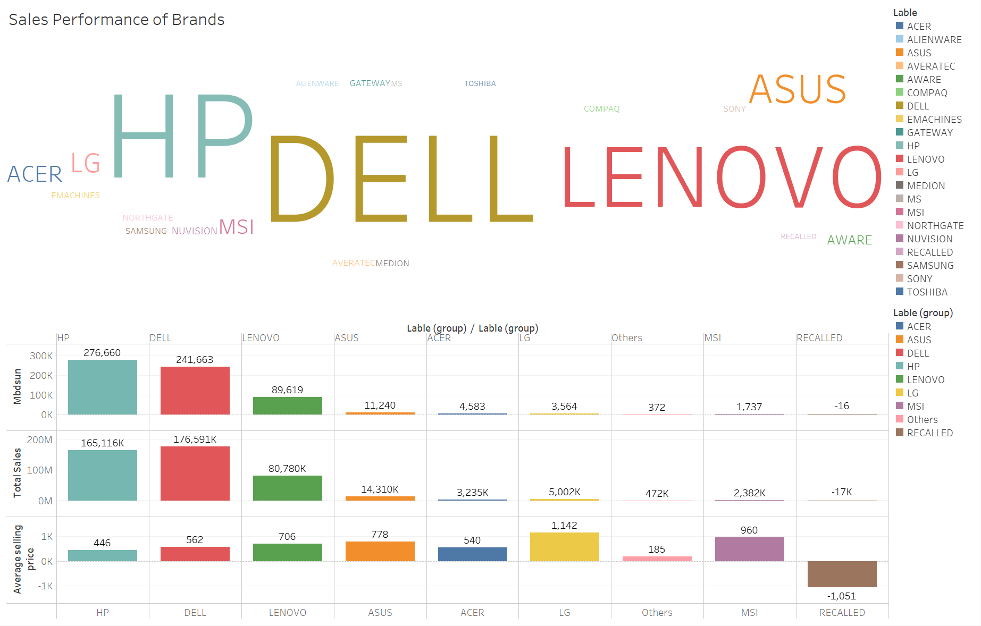
1st Question
TOP THREE BRAND:
DELL
HP
LENOVO
GRAPHS TYPES:
Word Cloud
Bar Chart

Slide 7
02
Returns Analysis
Can we calculate the average refund number and rates of appliance brands based on sales as well as sales quantity?

Slide 8
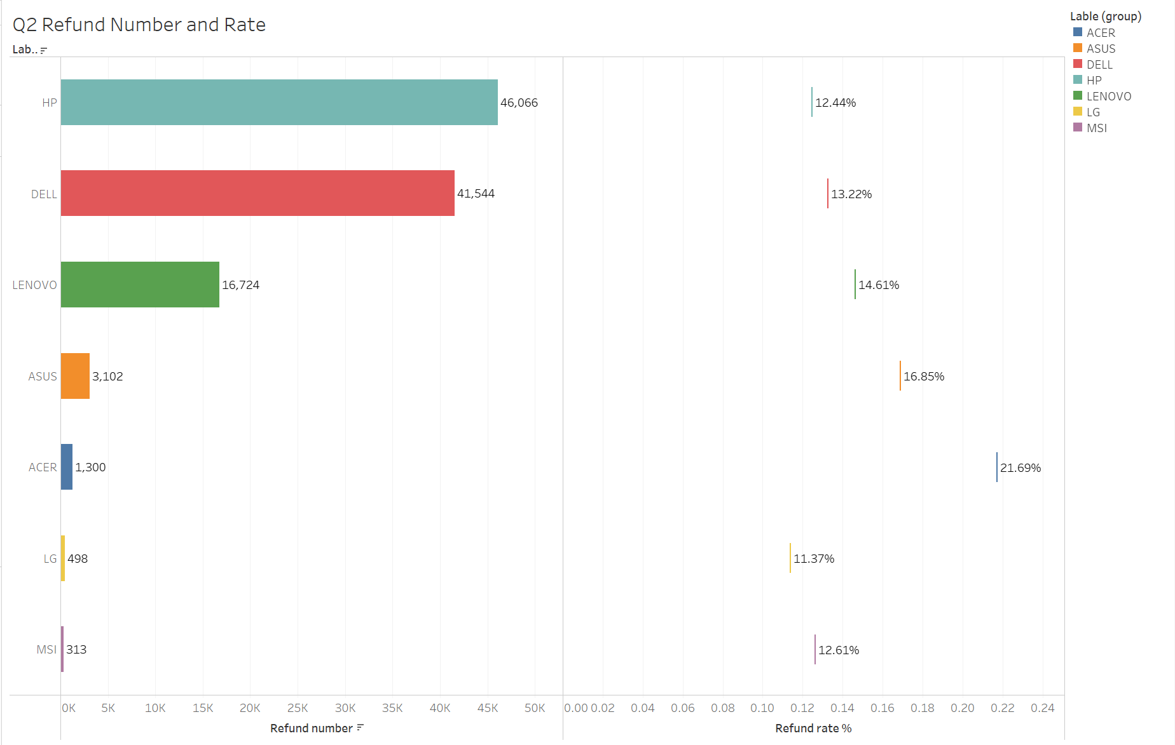
2nd Question
TOP TWO REFUND QUANTITY:
HP
DELL
TOP TWO REFUND RATES:
ACER
ASUS
GRAPH TYPE: Bar Chart & Gantt Bar

Slide 9
03
Sales Analysis
Which day of the week has the best sales?
Whether sales are subject to holiday marketing?

Slide 10
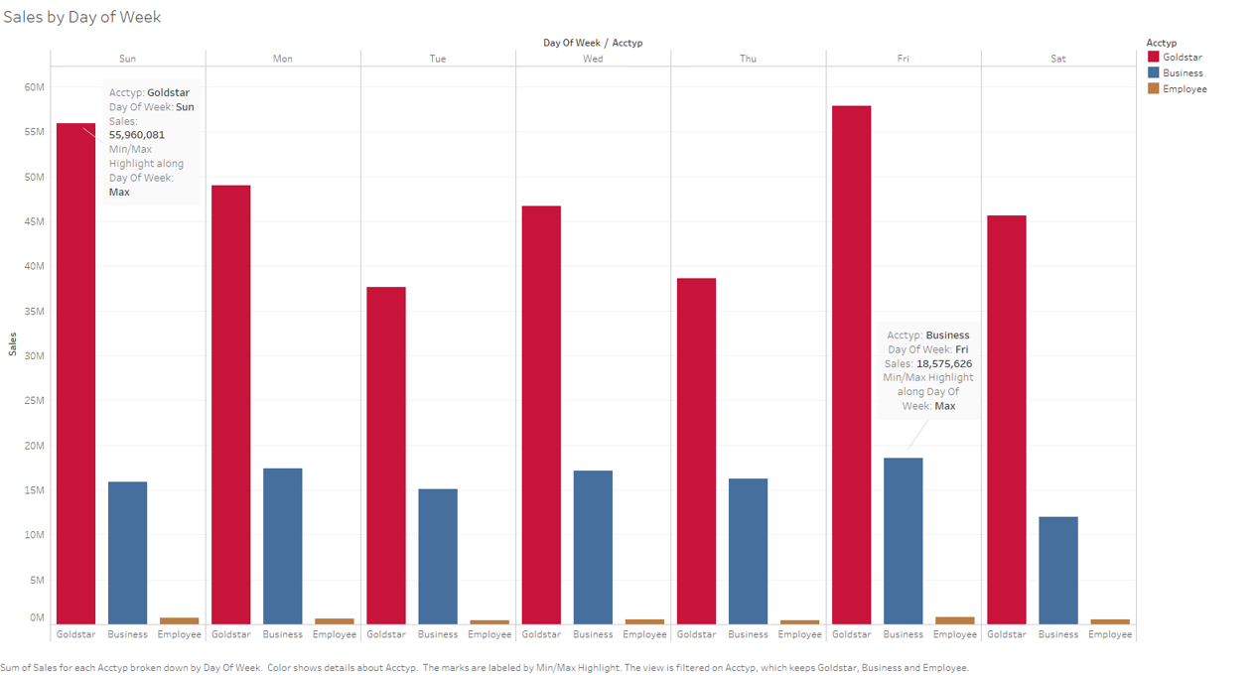
3rd Question
Highest Sales Day of Week:
Friday – Business
Sunday - Goldstar
Main Customer:
Goldstar
GRAPH TYPE: Bar Chart

Slide 11
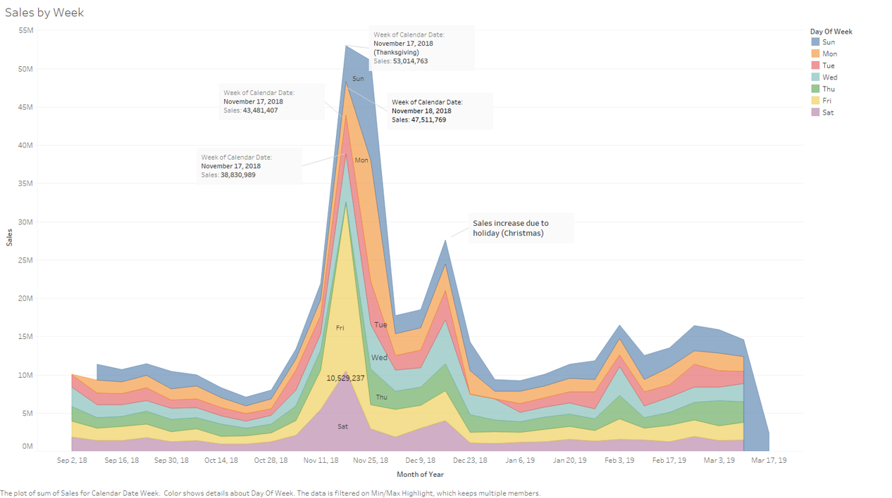
3rd Question
Reason of Sales Increase
Holiday
Thanksgiving
Christmas
GRAPH TYPE: Area Chart

Slide 12
04
Inventory Analysis
Which items should we stock more in which region, during different months of the year, based on the sales?

Slide 13
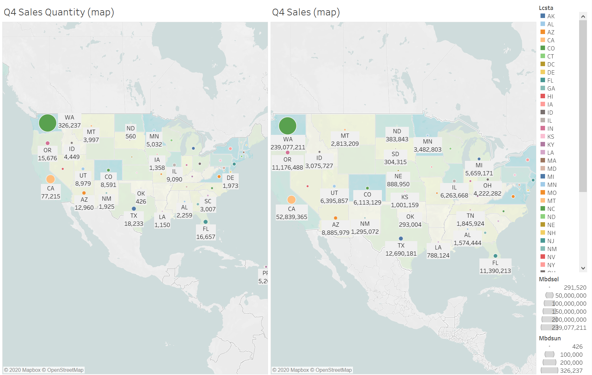
4th Question
Top TWO STATES:
WA
CA
EC, NW and BD are located in the state of WA
GRAPH TYPE: MAP

Slide 14
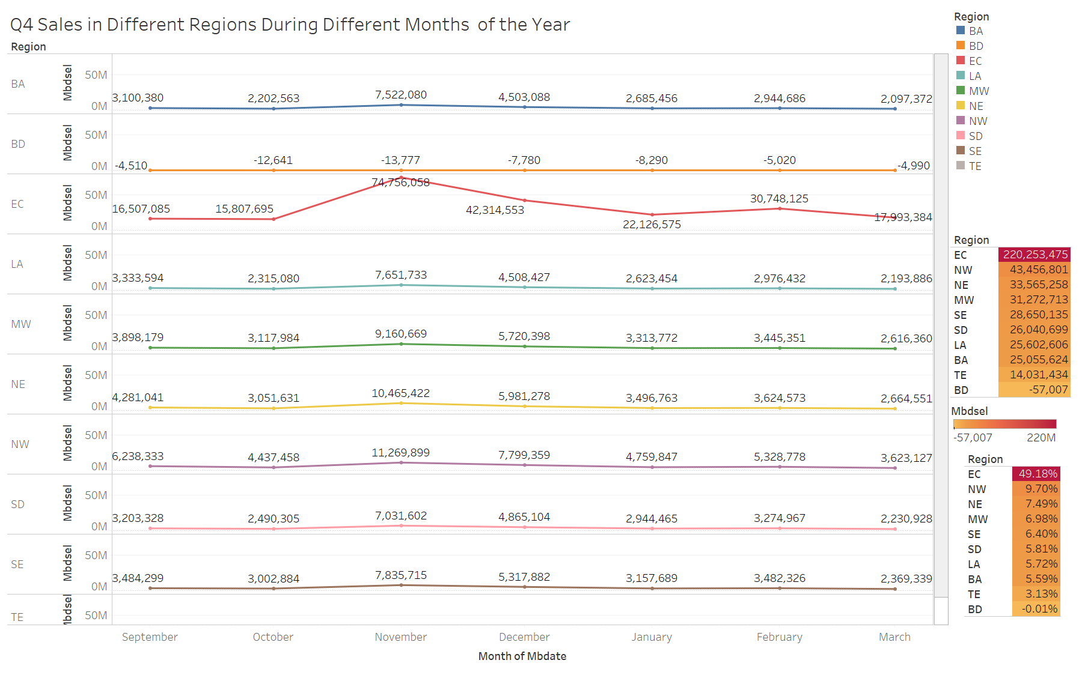
4th Question
November is high peak on the whole
EC is the largest sales among all regions
EC & NW in the State of WA: Nearly 60% of total sales
GRAPH TYPES: Line Chart & Square Chart

Slide 15
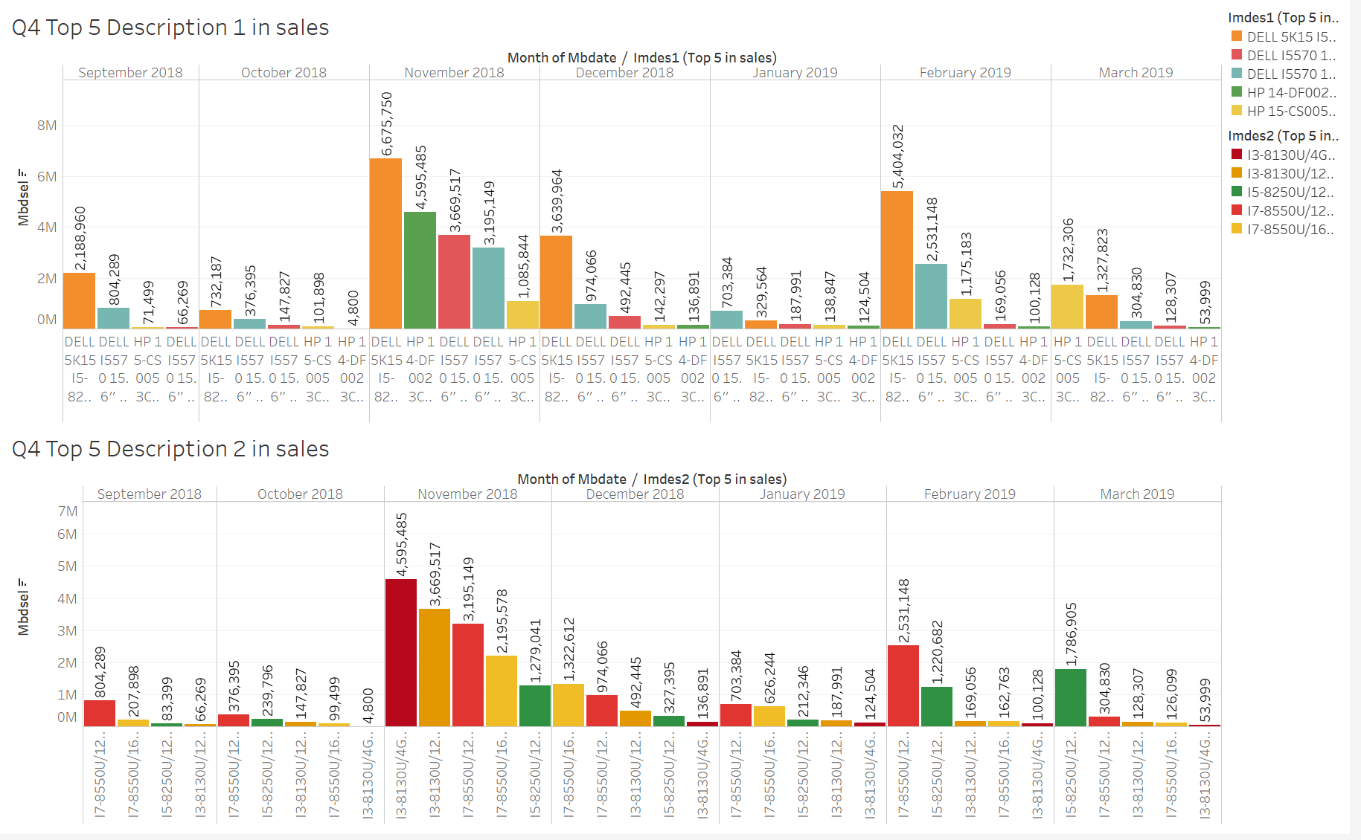
4th Question
TOP FIVE IMDES1 of EC REGION In Nov:
DELL 5K15 I5-8250U/12/1/T,
HP 14-DF0023CL 14" LT
DELL I5570 15.6" LT
DELL I5570 15.6" TCH LT
HP 15-CS0053CL 15.6" LT
TOP FIVE IMDES2 of EC REGION In Nov:
I3-8130U/4GB/128SSD
I3-8130U/12GB/1TB
I7-8550U/12GB/1TB
I7-8550U/16GB/512SSD
I5-8250U/12GB/1TB
GRAPH TYPE: Bar Chart

Slide 16
05
Warehouses Ranking Analysis
Can we rank warehouse based on the sales of items of quantity as well as Dollars?

Slide 17

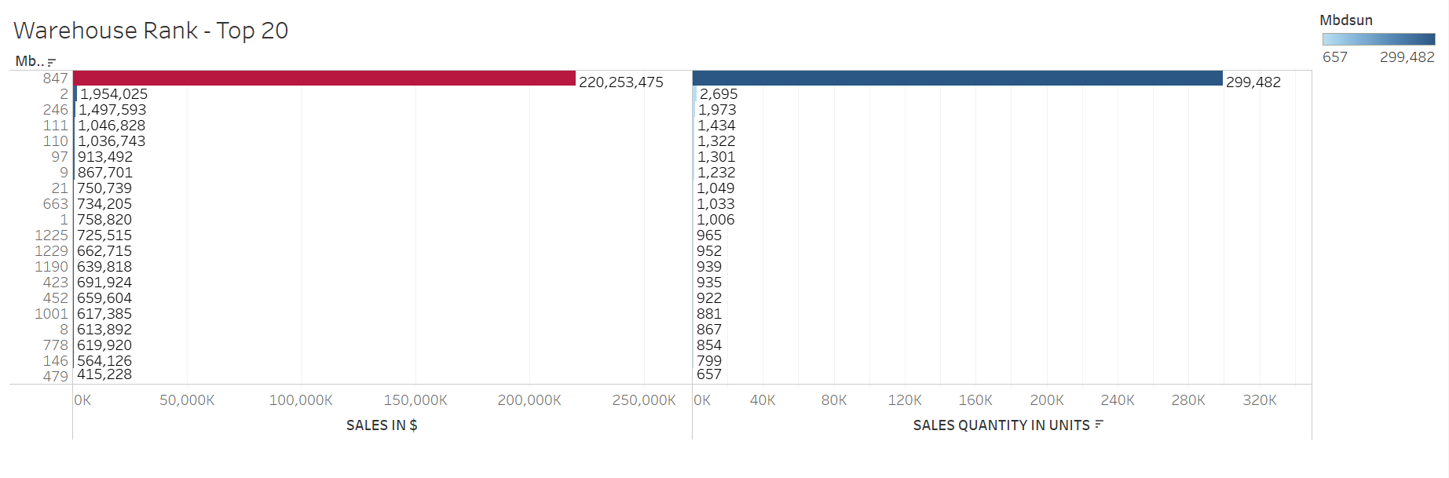
5th Question
No.847 is far ahead of other warehouses
Sales More than 1,000k
No.2
No.246
No.111
No.110
GRAPH TYPE: Bar Chart & Square Chart

Slide 18
06
Correlation Analysis
Is there a correlation of items to account type of the members?

Slide 19
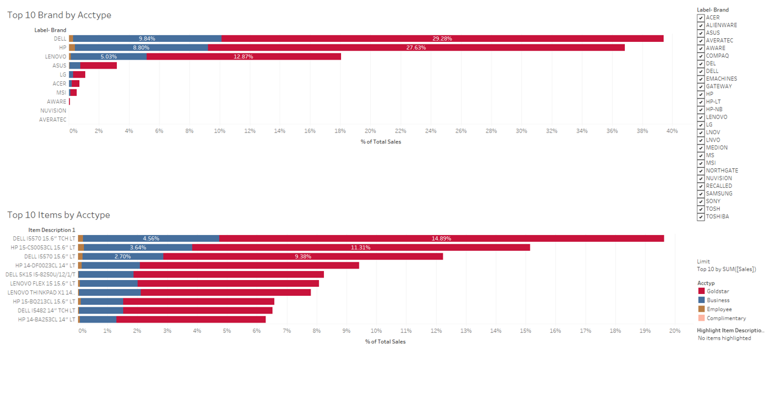
6th Quesion
All customers prefer Dell, HP, Lenovo
15.6” Laptop is the best size for individual and business customers
GRAPH TYPE: Bar Chart

Slide 20
Summary
Top Three Brand: Dell, HP, Lenovo
Dell and HP: Good Quality
Asus and Acer: Need to improve the quality control of the products
Best day of week sales: Friday(Business) ; Sunday(Goldstar)
Holiday season impacts sales performance
Top Two State of Sales: WA and CA
EC(US Ecommerce) and NW are approximately 60% of the total sales among all regions
EC (Warehouse 847) has the highest sales performance
Warehouse Sales Rank Two to Five: Portland(OR), Christiana(DE), Tigard(OR), Issaquah(WA)
Individual customers and business customers are both prefer purchase Dell, HP, Lenovo electronic products
Goldstar member is the largest account type of sales and is more than 70% of the total sales
15.6” laptop is more popular than other size laptop or monitor
No.847 warehouse accounts for nearly 50% of the total sales and shipping goods in U.S. would be dependent on this warehouse

Slide 21

Thanks
Any questions?

